Slide 1
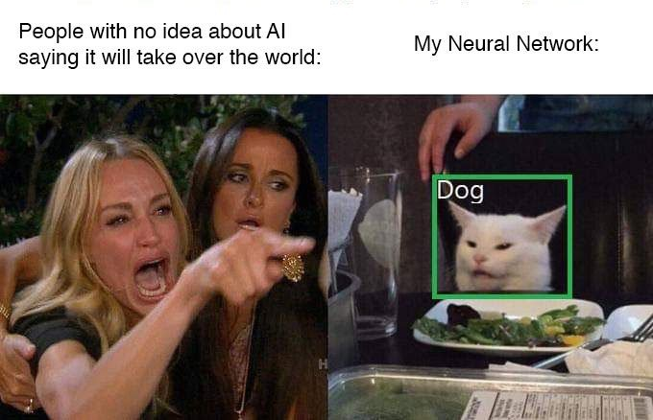
People that say AI will take over the world:
Meanwhile, my own AI:
Object Detection using YOLOv4
Anuj Tiwari
Notes:
We will have a brief look at object detection using a deep learning model. We will be using a sample dataset to create an object detection model.

Slide 2
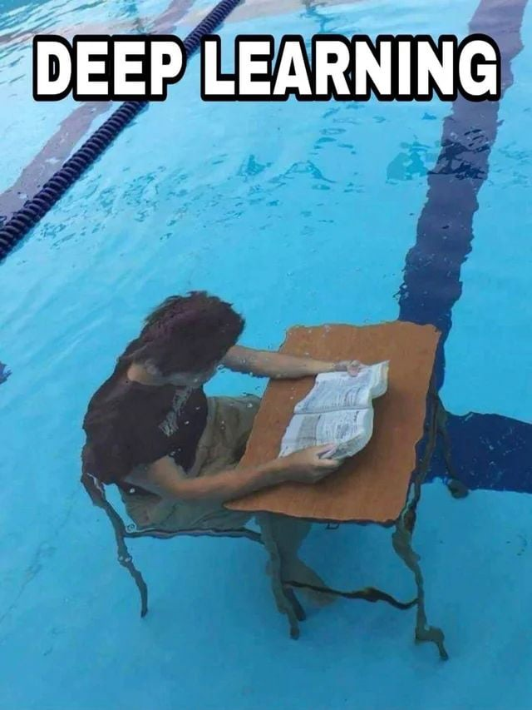
Overview
We will have a brief look at object detection using a deep learning model called YOLOv4
We will be using a sample dataset to create an object detection model
This method can be applied to any dataset but is mainly useful when dealing with data in excess of 1000+ similar images
We usually take a portion of these images from a large dataset and make a model so we can extract information out of the rest of the dataset efficiently
As mentioned in the previous talk, we have utilised this model to characterize the growth and lysis of E. coli cells

Slide 3
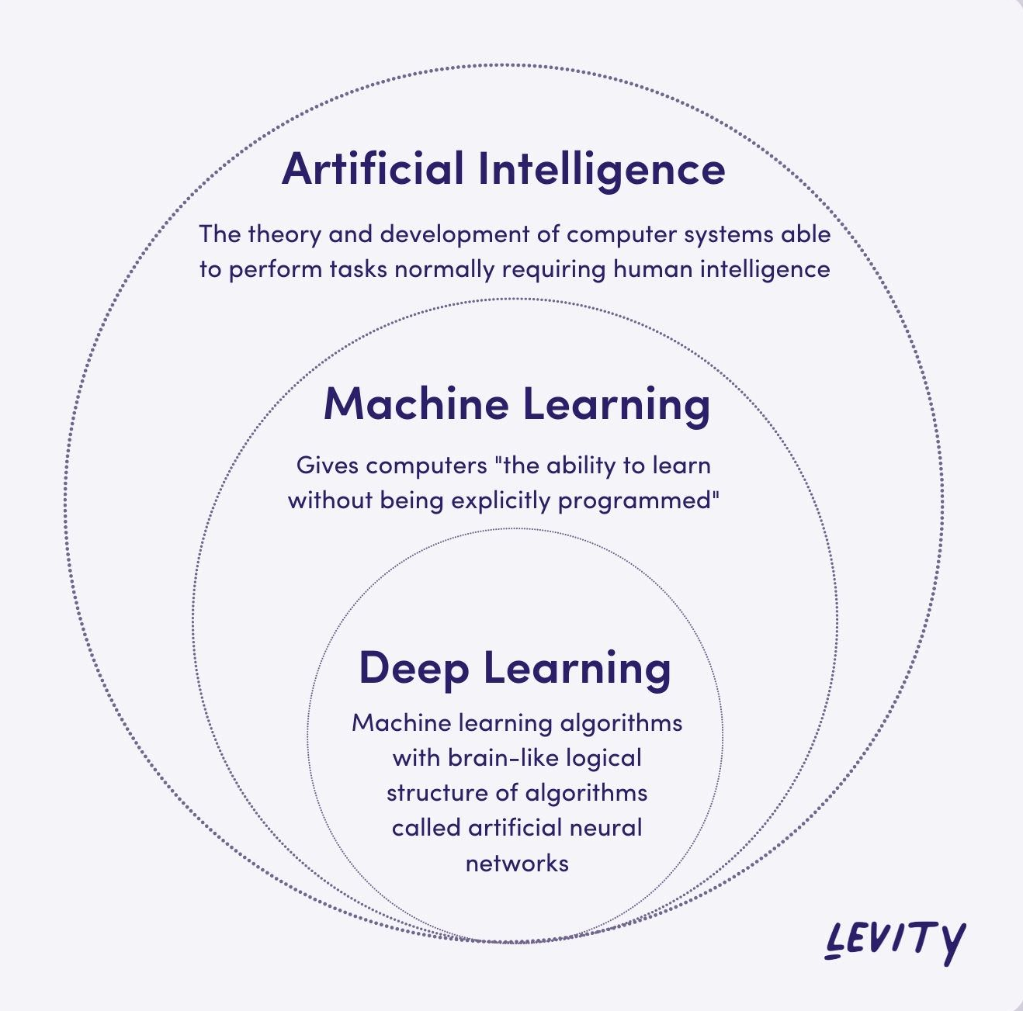
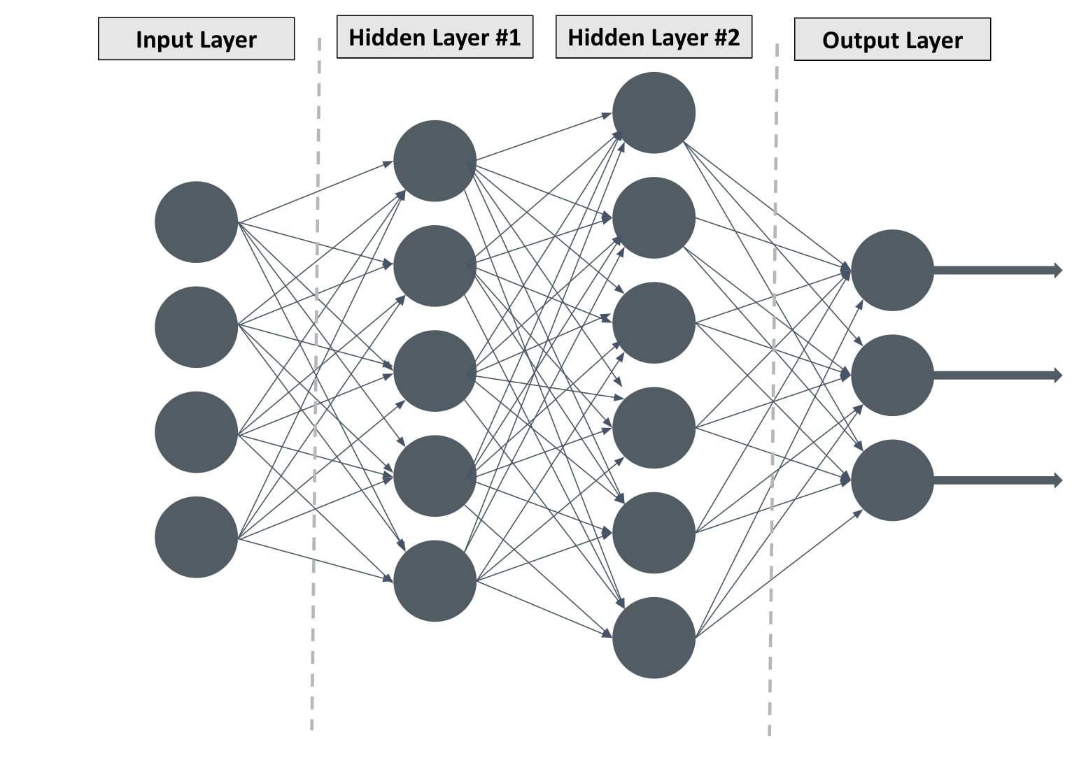
What is deep learning?
A class of machine learning techniques that exploit many layers of non-linear information processing for supervised or unsupervised feature extraction and transformations for pattern analysis and classification.

Slide 4
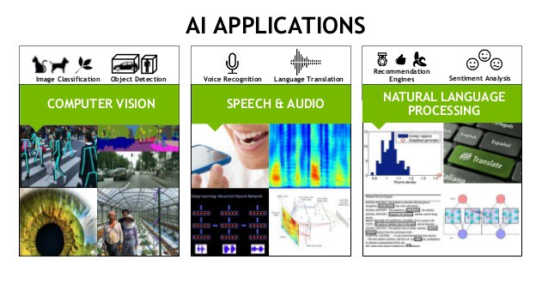






Deep learning Applications

Slide 5
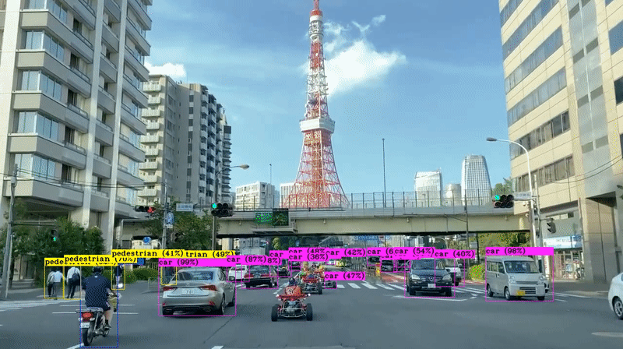
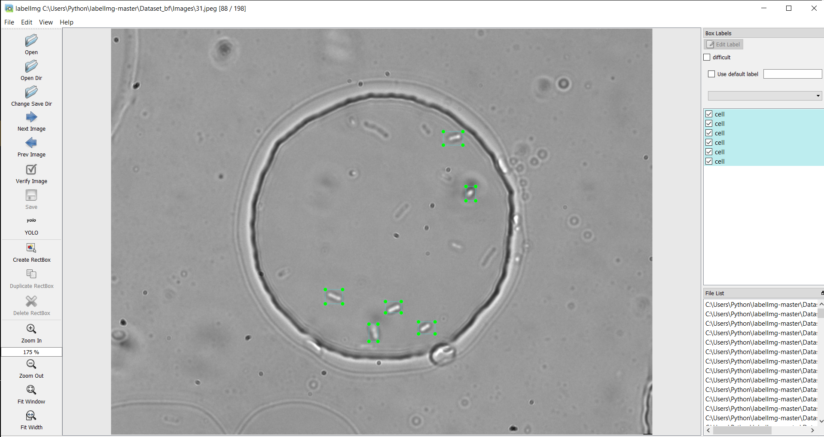
Introduction – YOLO architecture
YOLO (You Only Look Once version) is a one stage object detection framework that utilizes Supervised Machine Learning to detect a custom object of interest
This framework is typically used in development of self-driving cars as well as to count objects and motion monitoring
Image ref: Alexey AB YOLOv4
Labelling our object of interest

Slide 6
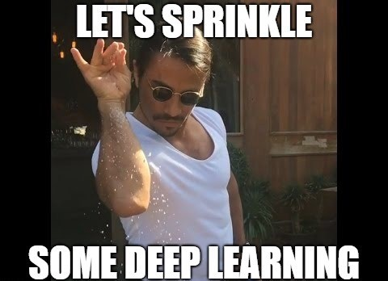
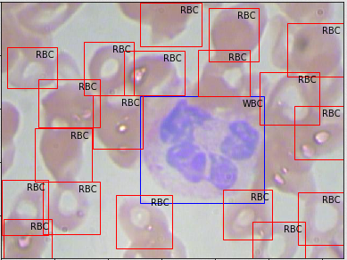
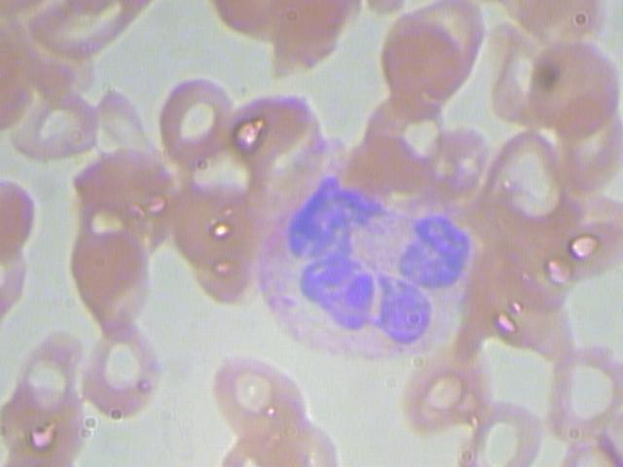
What will we do today?
Input
Output
Make this deep learning model
We will be making a model to detect different types of blood cells
(RBC, WBC, Platelets) from images

Slide 7
Let’s Begin
Step 1: Downloading and labelling our dataset
Step 2: Splitting our dataset for training and validation and training the model
Step 3: Checking the accuracy of the model by performing detections using our trained model
Prerequisites and Useful links
Python 3.7 or higher : Anaconda integrated will make things very easy
Download this repository :
https://github.com/tiwarianuj2006/Yolov4-workshop
https://colab.research.google.com/drive/1q2yE2vj035HKk6d4IWH-vPmTIAU0KMF-

Slide 8
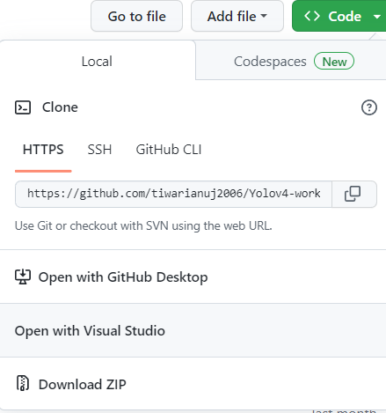
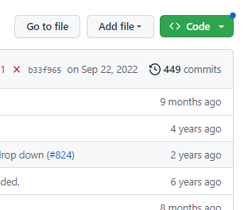
Downloading prerequisites
Step 1: Follow the link:
https://github.com/tiwarianuj2006/Yolov4-workshop
Step 2: Download the above directory following these steps:
Step 3: After downloading, extract this at any desired location. We will revisit this folder at different steps

Slide 9
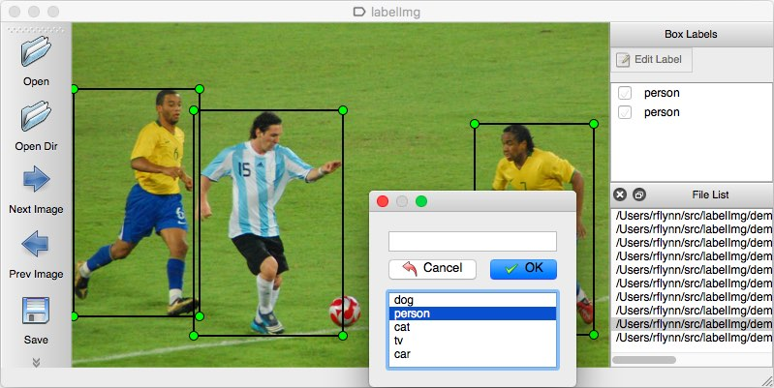
What is labelling?
Labelling refers to drawing a rectangular box around the object of interest for images in a given dataset and correctly tagging it.
We will be using a Python application called LabelImg to label our dataset today.
https://github.com/heartexlabs/labelImg

Slide 10
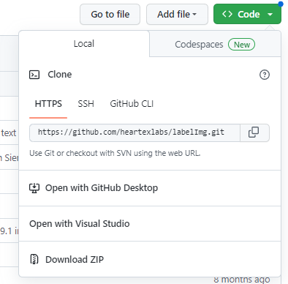
Installing LabelImg
Step 1: Follow the link:
https://github.com/heartexlabs/labelImg
Step 2: Download the LabelImg directory following these steps:
Step 3: After downloading, extract the labelImg-master at any desired location

Slide 11
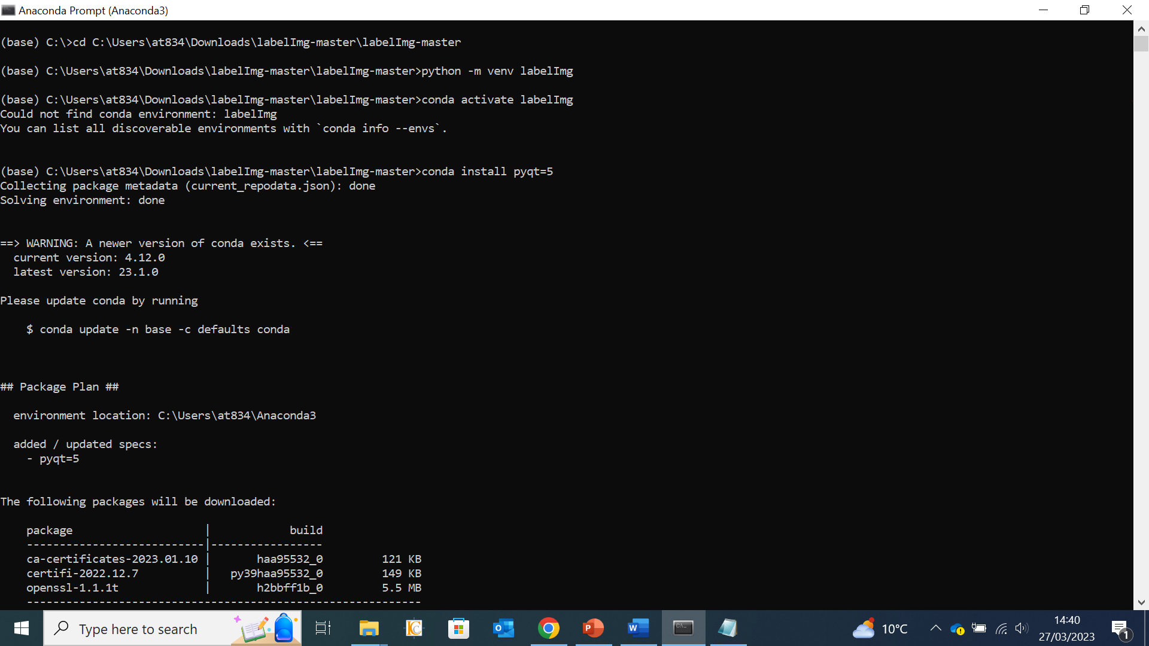
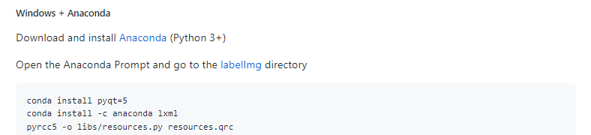
Installing LabelImg
Step 4: Open Anaconda and go to the
LabelImg directory
Step 5: Install dependencies using commands

Slide 12
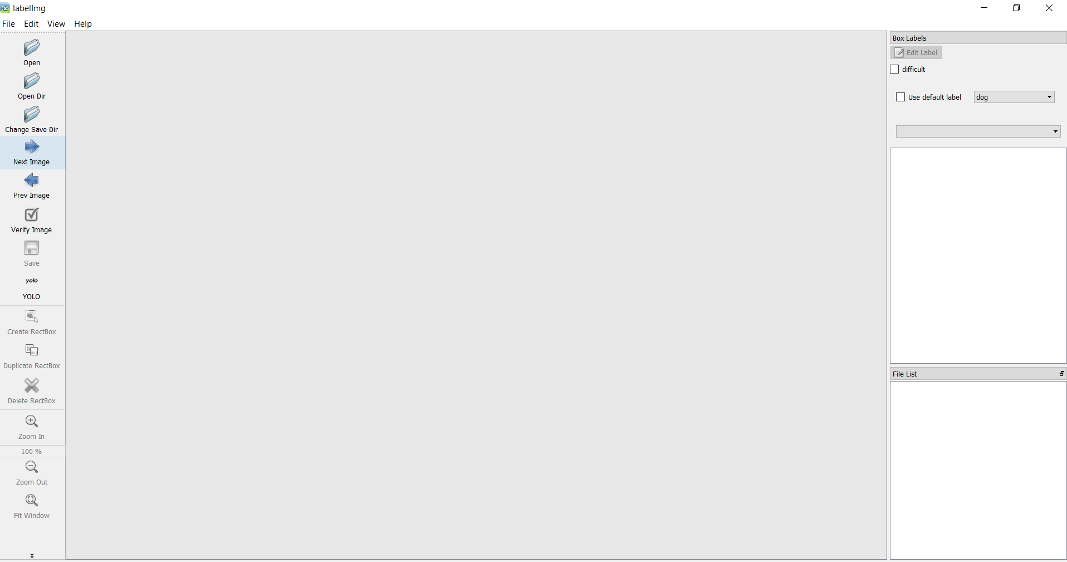

Slide 13
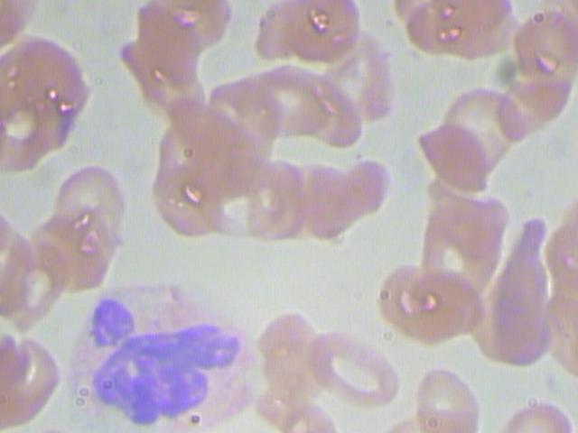
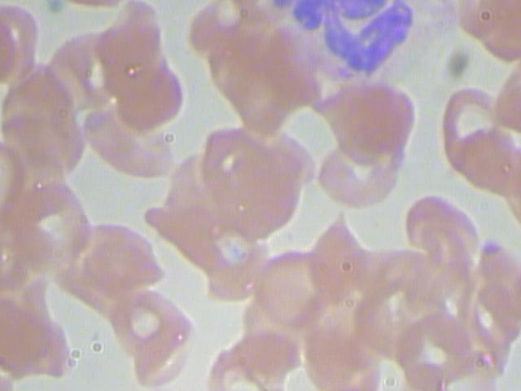
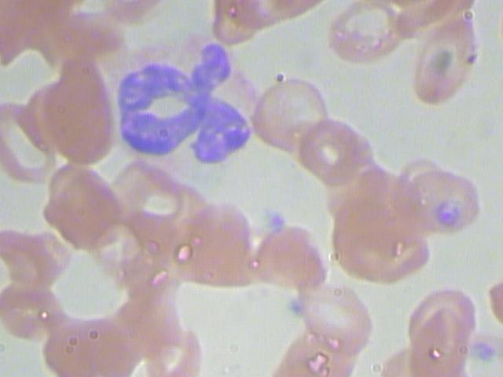
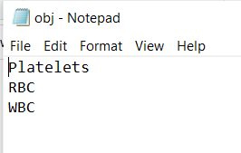
Labelling our dataset
Step 1: Download the zip file containing the dataset (Dataset_blood_cells) from GitHub link in the previous slide
Step 2: Copy the extracted folder Dataset_blood_cells into the LabelImg-master directory
Step 3: Open folder Dataset_blood_cells and create a txt file called “classes.txt”
Step 4: Fill the classes.txt with the names of classes that we intend to detect. In this case the classes being: RBC, WBC and Platelets

Slide 14
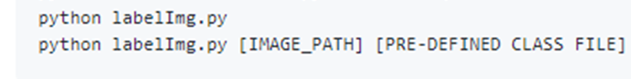
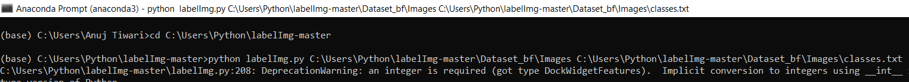
Labelling our dataset
Step 5: Open the LabelImg-master directory in the anaconda prompt and activate the virtual environment we created earlier
Step 6 : To open LabelImg, use following
commands
Location of our images
Calling the LabelImg GUI
Location of our classes file

Slide 15
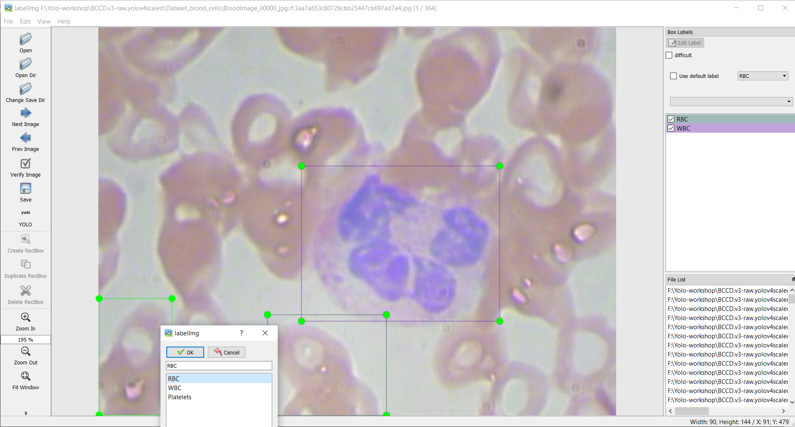

Slide 16
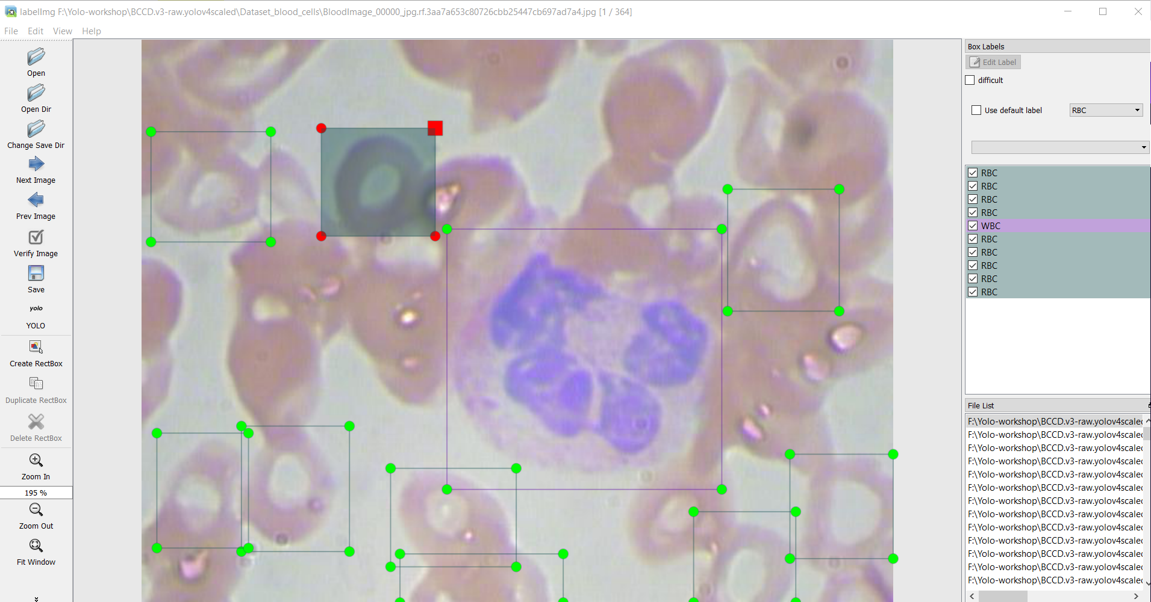
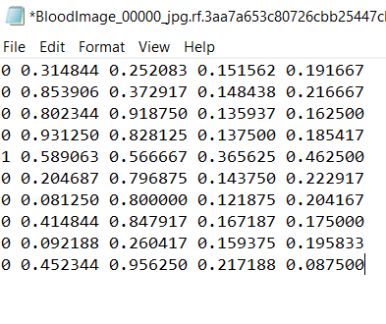
class
a
b
c
d

Slide 17
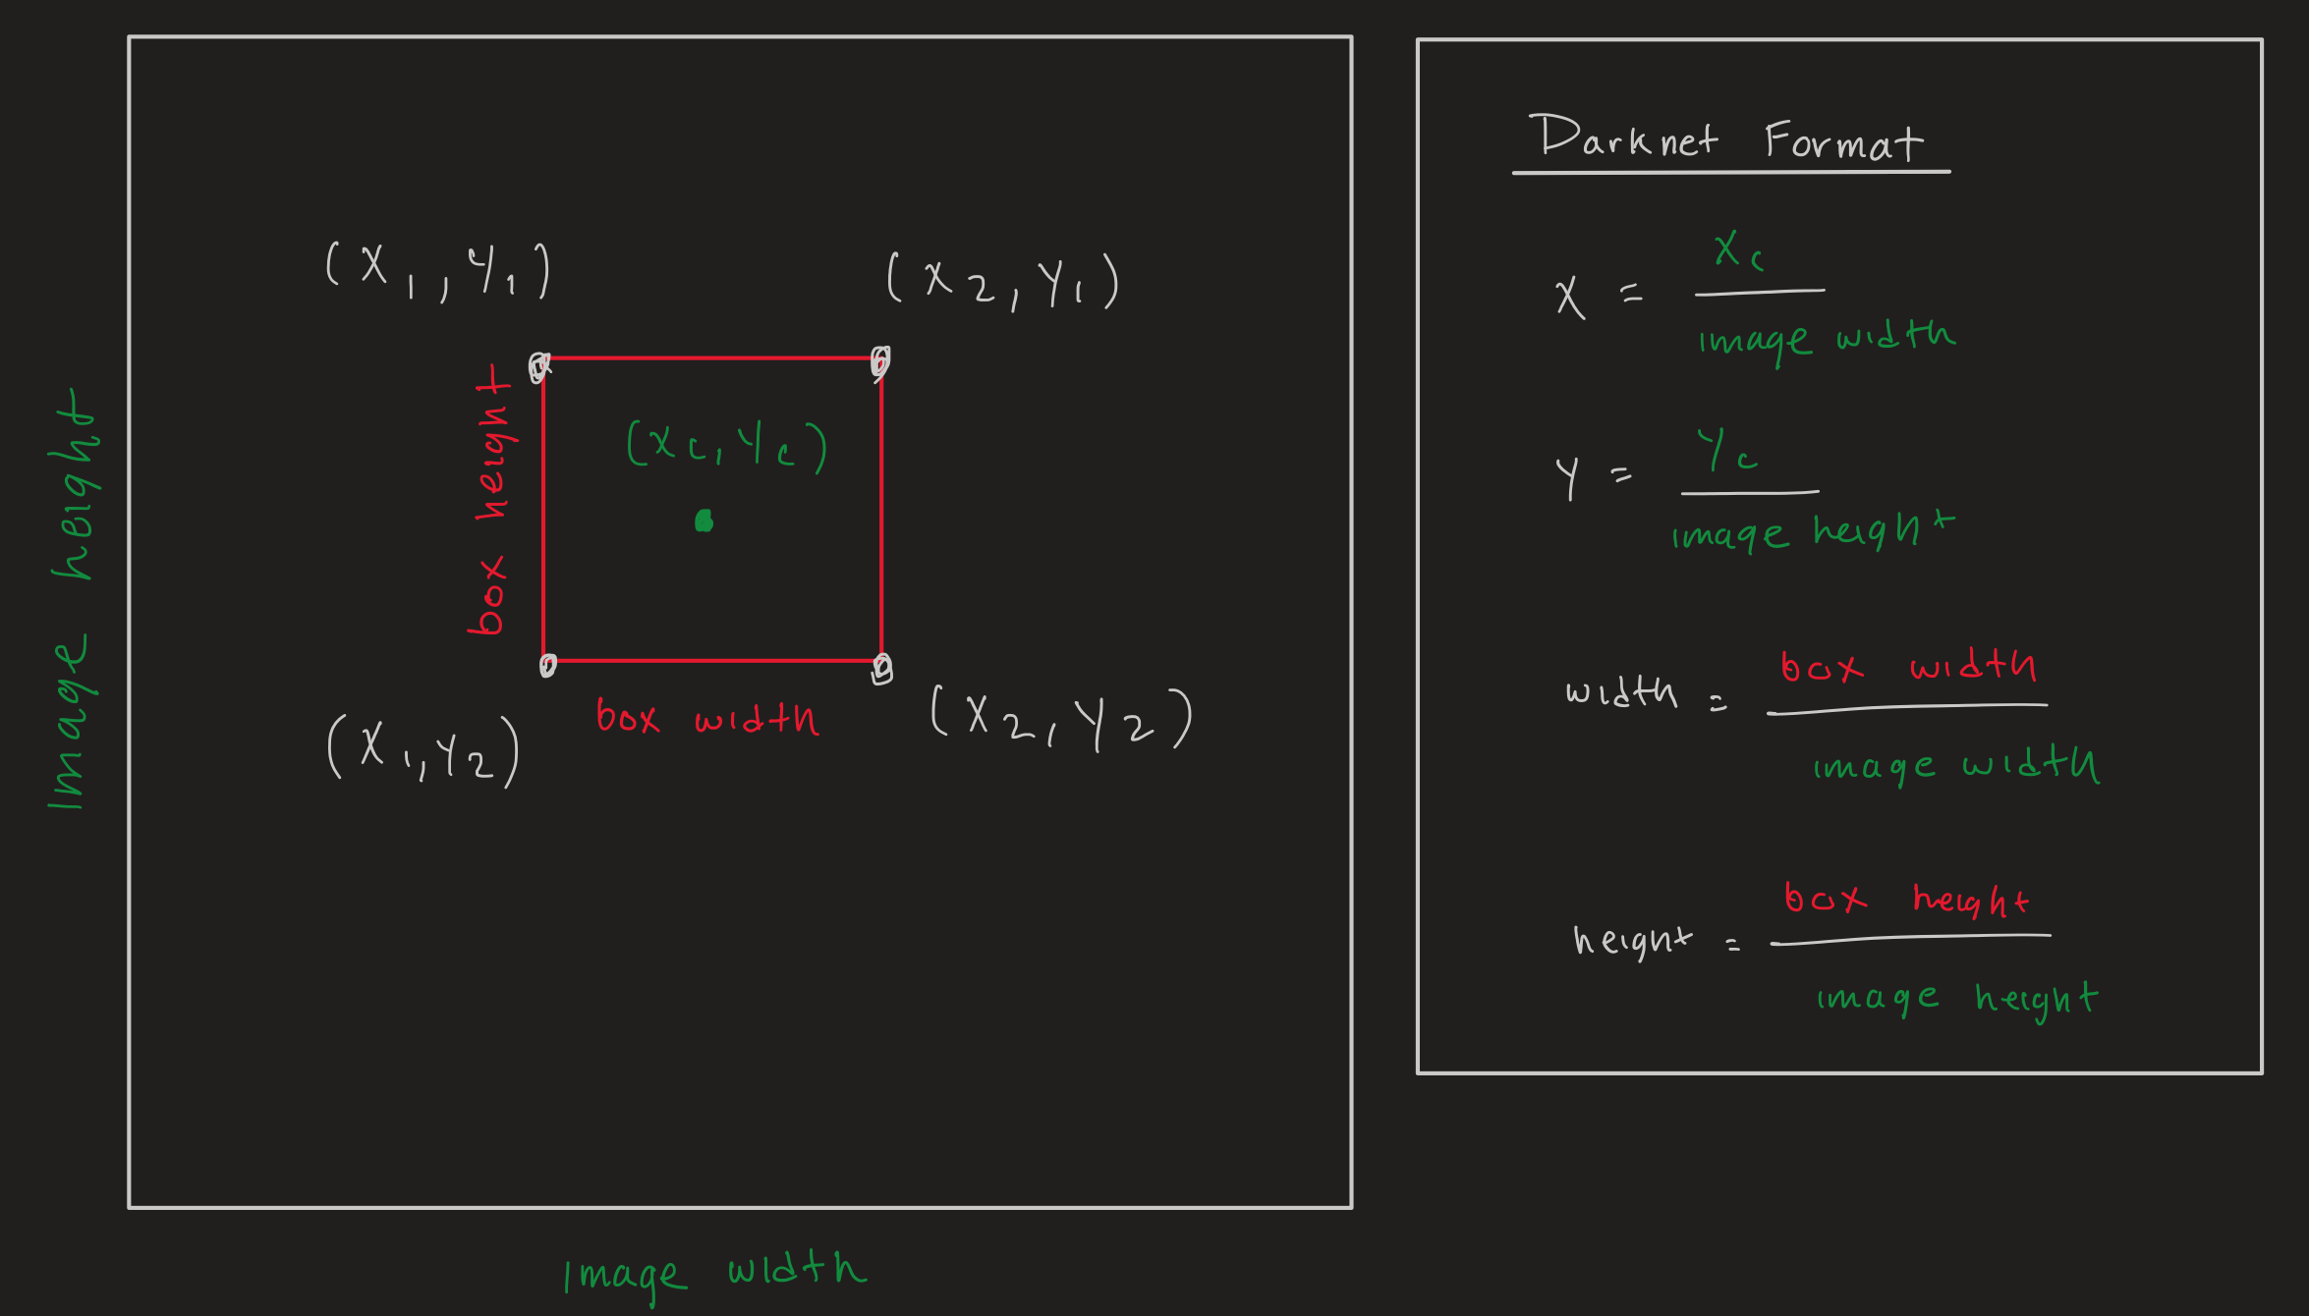
Labelling our dataset : How is it saved?
a
b
c
d
Annotations are saved as : 0/1/2(class) a b c d

Slide 18
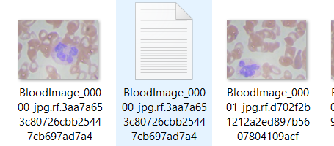
Labelling our dataset : How is it saved?
The text file is saved as .txt with the same name of the image. This is important as each annotation will be referred in the training using the file name.
Let’s label a few images!

Slide 19
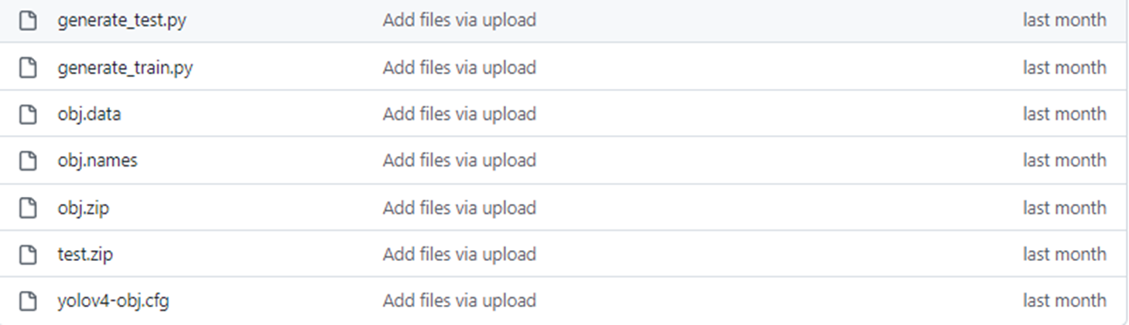
Splitting our dataset
The Already_labelled zip file consists of the labels for all the images in our dataset.
The dataset is split into 70:15:15 ratio for training and validation.
The 70% data split will be used for training the YOLOv4 model and is stored in a folder called “obj”.
One part of the 15% data split will be used to calculate model parameters such as precision, recall, average precision. This data is stored in a folder called “test”
Other part of the 15% data split will be used to perform detections on images not used for training

Slide 20


Training the YOLOv4 model using Google CoLab
Colaboratory, or “Colab” for short, is a product from Google Research. Colab allows anybody to write and execute arbitrary python code through the browser, and is especially well suited to machine learning, data analysis and education. It provides access to free of charge GPU.
Notebook to be used:
https://colab.research.google.com/drive/1q2yE2vj035HKk6d4IWH-vPmTIAU0KMF-
Step 1: Log in to your Google account on any browser
Step 2: Open Google drive in a separate tab

Slide 21
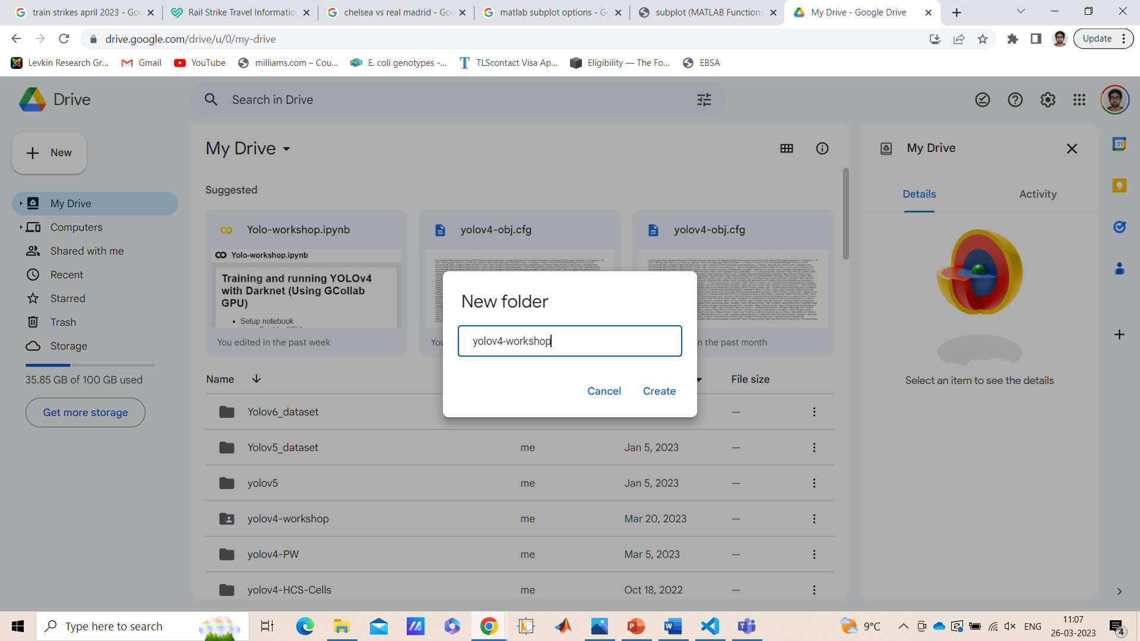
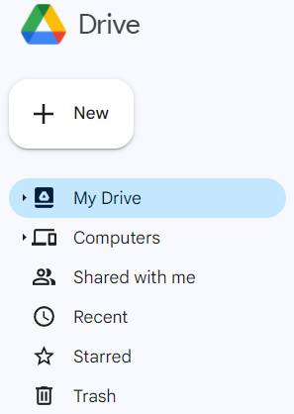
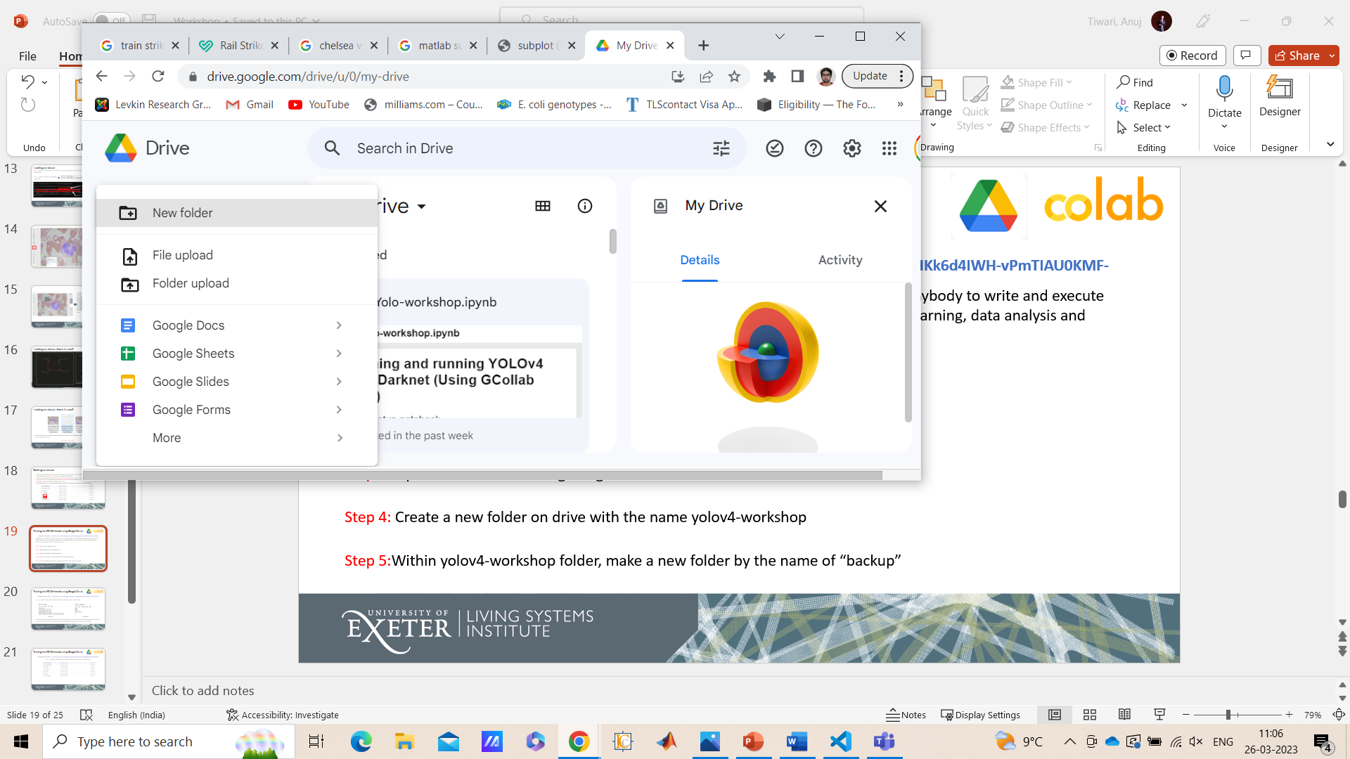
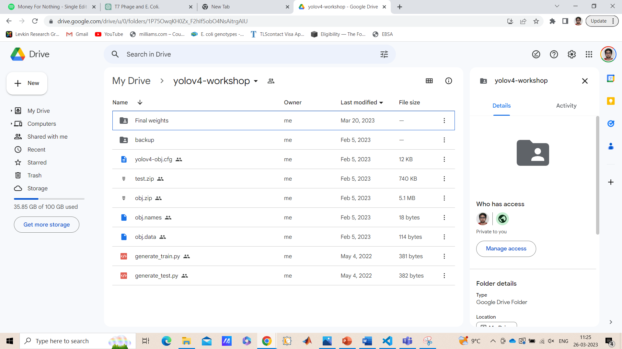
Training the YOLOv4 model using Google CoLab
Step 5
Step 3
Step 4
Step 6

Slide 22
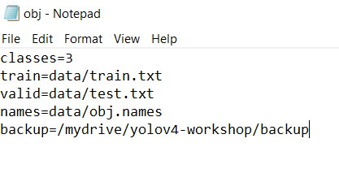
Training the YOLOv4 model using Google CoLab
Notebook to be used:
https://colab.research.google.com/drive/1q2yE2vj035HKk6d4IWH-vPmTIAU0KMF-
Step 7: Open the obj.names and obj.data files in Notepad to check the content
obj.data
obj.names
While working on the virtual machine (VM), the obj.data file is used to refer to location of files stored in the VM as well as the location of the backup folder where training weights will be stored every 100 iterations

Slide 23
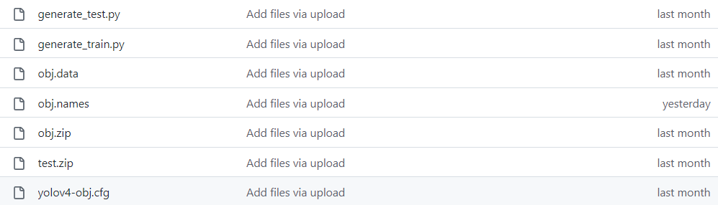
Training the YOLOv4 model using Google CoLab
Notebook to be used:
https://colab.research.google.com/drive/1q2yE2vj035HKk6d4IWH-vPmTIAU0KMF-
Step 8: Upload the following files to the yolov4-workshop folder on Google Drive

Slide 24
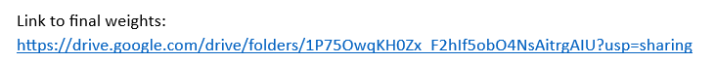
Training the YOLOv4 model using Google CoLab
Notebook to be used:
https://colab.research.google.com/drive/1q2yE2vj035HKk6d4IWH-vPmTIAU0KMF-
Step 9: Unzip Images-test and upload to yolov4-workshop folder
Step 10: Download the final_weights file using the link in Important links document and upload it to backup folder in yolov4-workshop directory

Slide 25
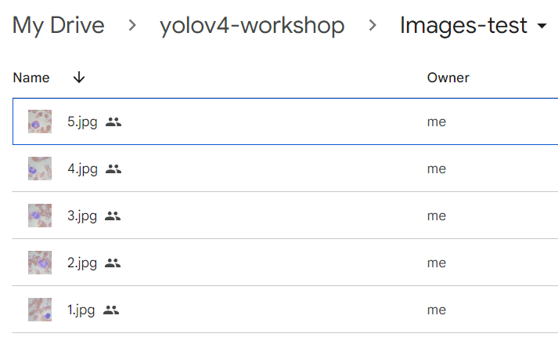
Training the YOLOv4 model using Google CoLab
Images-test
Step 9: Unzip Images-test and upload to yolov4-workshop folder

Slide 26
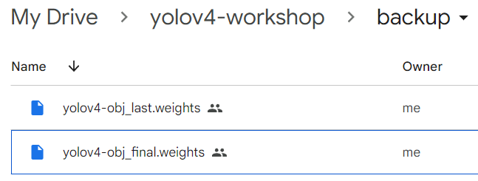
Training the YOLOv4 model using Google CoLab
Step 10: Download the final_weights file using the link in Important links document and upload it to backup folder in yolov4-workshop directory
Images-test

Slide 27
Training the YOLOv4 model using Google CoLab
Notebook to be used:
https://colab.research.google.com/drive/1q2yE2vj035HKk6d4IWH-vPmTIAU0KMF-
Let’s move on to the CoLab notebook

Slide 28
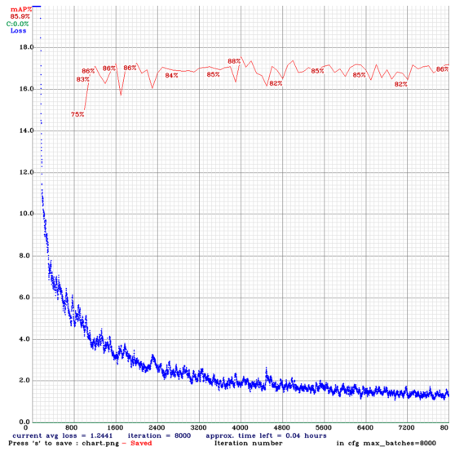
Results of training:
Link to final weights after training:
https://drive.google.com/drive/folders/1P75OwqKH0Zx_F2hIf5obO4NsAitrgAIU?usp=sharing

Slide 29

Thanks for coming to my talk

